Slide 1




BDM CAPSTONE PROJECT
Enhancing Profitability and Customer Retention for an Electronics Shop Amidst Online Competition
Presented By:
Hiya Syal
Roll number: 23f3003216

Slide 2


Overview
Introduction of Business
Problem Statement
Problem Solving Approach
Data Collection
Analysis Process
Results
Recommendations
Conclusion

Slide 3
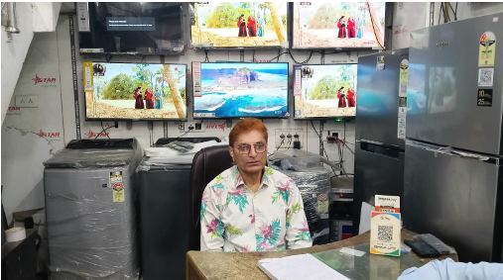

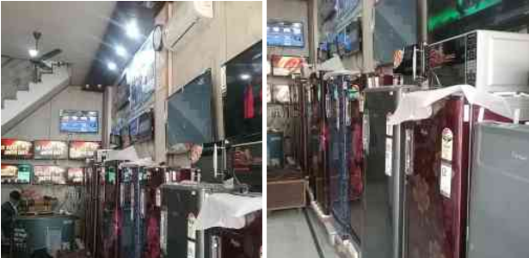
Problem Statements
Introduction
Reduced Profit Margins due to competition from online retailers on platforms like Amazon and Flipkart who offer discounts and deals that the shop cannot match.
Customer Bargaining Pressure, as many customers compare prices with online platforms and negotiate for lower rates.
Decreased Sales Volume, affecting overall profitability and sustainability.
Name : Syal Enterprises
Owner : Mr. Sunil Syal
Address : Sarai Rd, Sondhi Chowk, Phagwara, Punjab 144401
Established: 1980 ; family-owned B2C business
Products Offered: Electronics such as washing machines,refrigerators,LED TV, microwave,air fryer,iron,induction,gas stoves etc.
Current Challenges: Rising competition from online retailers, reduced profit margins, and high customer price sensitivity.

Slide 4

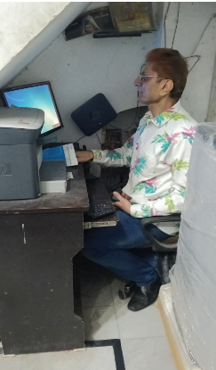
Problem Solving Approach
Enhanced Data Management for Insights
Developed a structured dataset by manually collecting and organizing sales data using Excel.
Leveraged tools like pivot tables and formulas to streamline analysis and ensure accurate weekly sales tracking.
01
Identifying Key Sales Trends
Conducted descriptive analysis to map seasonal demand, such as the Diwali sales spike, using line and pie charts for clarity.
Highlighted top-performing and low-performing products to prioritize inventory adjustments.
02
03
Combatting Online Retail Competition
Analyzed customer behavior to identify periods of reduced footfall due to online sales festivals.
04
Balancing Profit Margins Amid Bargaining Pressure
Mapped the impact of customer bargaining on high-value items using diagnostic tools.

Slide 5
Data Collection
Time Period of Data Collection: 2 months [Sep '24 and Oct’24]
● Sales Data : This sheet holds the data of all the items of the shop,weekly sales
of each item.
● Data (Brand-Wise with Pricing): This sheet holds the data of Product and the associated Brand,its Model/Capacity/Features, Price (INR) and the quantity sold.
● Revenue Data : This sheet holds the revenue data across two months day wise.
● Revenue Data (Weekly) : This sheet holds the revenue data generated weekly.

Slide 6
Data Analysis
1. Data Collection and Pre-Processing:
Data Challenges: Inconsistent or paper-based records required manual entry.
Key Collected Data: Weekly sales quantities, item names, prices, revenue figures, and related expenses.
Formatting: Transposed and reorganized data into a structured, week-oriented format using Excel for easy analysis.
2. Analysis Methodology:
Descriptive Analysis:
Used statistical functions (MAX, MIN, AVERAGE) and created visualizations like pie charts (revenue contribution) and line charts (weekly trends).
Key Findings: Sales surged during Diwali (October), with washing machines and LED TVs driving revenue.
Diagnostic Analysis:
Explored reasons behind performance trends using Excel tools like pivot tables and correlations.
Findings:
Festive promotions in October boosted sales by 18% compared to September.
Inventory shortages during peak periods limited potential revenue growth.
Online shopping festivals and customer bargaining behavior impacted sales.
3. Tools and Techniques Used:
Excel functions for calculations, pivot tables for structuring data, and visual aids for interpretation.
Weekly summaries for trend analysis and cash flow tracking.

Slide 7
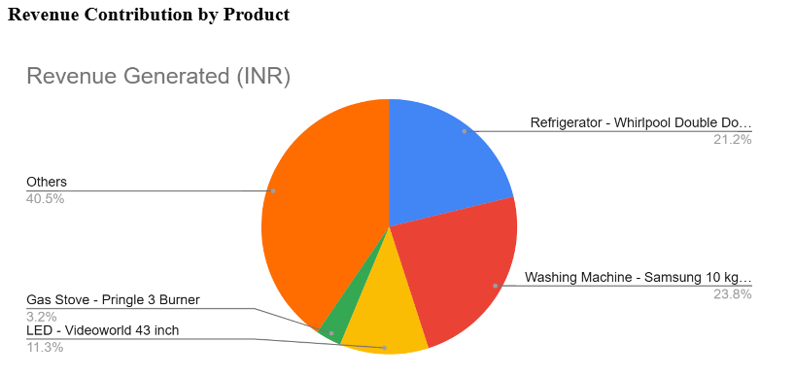
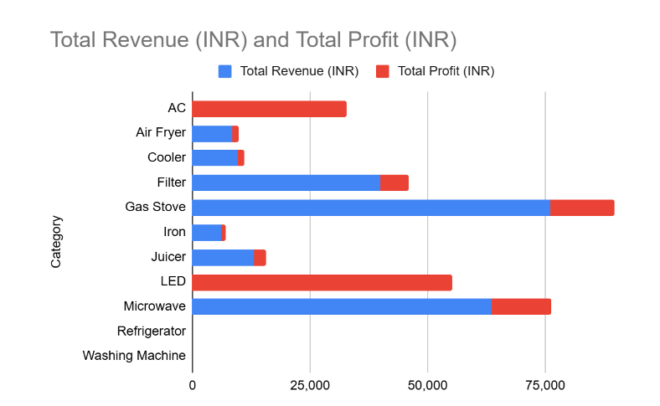
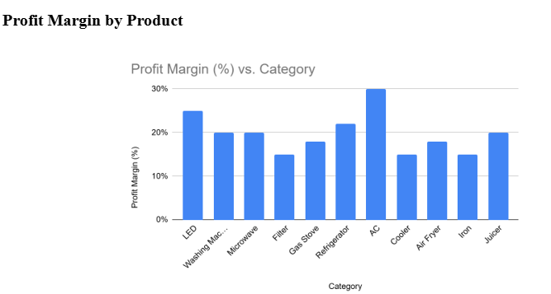
Results
Revenue and Profitability Insights
High-ticket items like Refrigerators and Washing Machines (Whirlpool, Samsung) dominate revenue. High-margin products like LED TVs and ACs are key contributors to profitability. Gas stoves and microwaves provide balanced revenue and profit contributions.
Revenue and Profitability Insigh

Slide 8
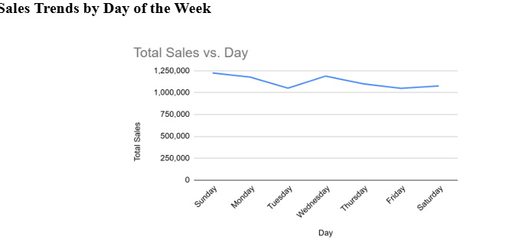
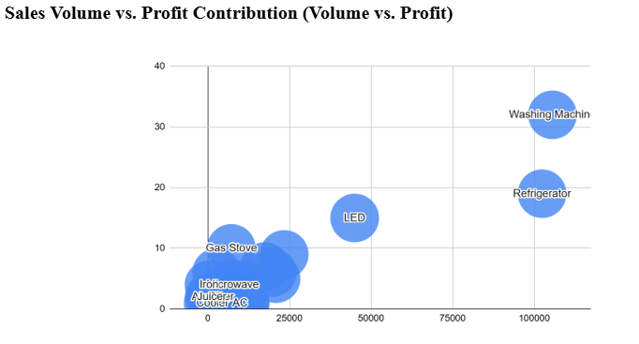
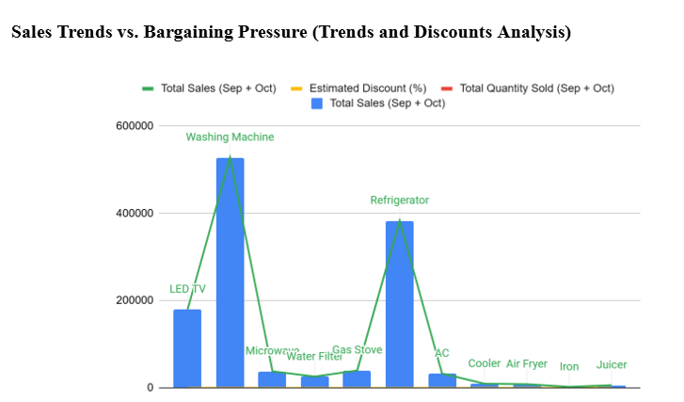
Results
Sales Trends and Strategies
High-volume products like Washing Machines vary in profitability.
Sundays and Wednesdays see peak sales.
Heavy discounts boost sales but reduce profitability.

Slide 9
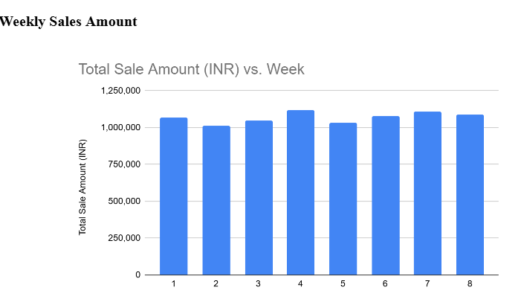
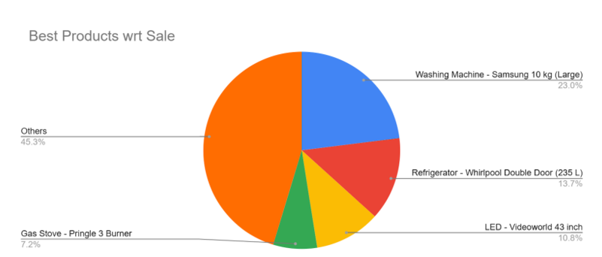
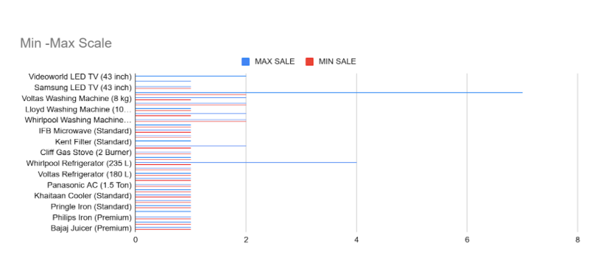
Results
Optimization and Inventory Management
Washing Machines (Samsung) and Refrigerators (Whirlpool) lead sales.
Sales dip during specific weeks.
High-performing brands outperform others significantly.

Slide 10


RECOMMENDATIONS
Focus on High-Ticket Items: Increase inventory and promote high-revenue items like Refrigerators (Whirlpool) and Washing Machines (Samsung) through bundling or in-store discounts to attract customers and boost sales.
Market Best-Selling Products: Highlight top-selling items such as Samsung Washing Machines and Whirlpool Refrigerators in promotional campaigns to build brand loyalty and drive repeat business.
Leverage Peak Sales Days: Implement time-sensitive promotions or flash sales on Sundays and Wednesdays to maximize foot traffic and capitalize on high sales volumes during these peak days.
Prioritize High-Margin Brands: Optimize the product mix by focusing on stocking high-margin brands and products while minimizing inventory of underperforming items to enhance profitability.
Enhance In-Store Value: Counter online competition by offering exclusive in-store promotions, bundled deals, and potentially adjusting weekend hours to increase footfall and cater to customer preferences.

Slide 11
Conclusion
Syal Enterprises can enhance its financial performance and competitiveness by leveraging data-driven strategies. Key insights highlight the significance of focusing on high-revenue products like Refrigerators and Washing Machines, optimizing inventory to meet demand fluctuations, and implementing targeted promotions on peak sales days such as Sundays and Wednesdays.
Effective inventory management, cost optimization for fixed expenses, and strategic marketing can improve operational efficiency and profitability. By prioritizing customer preferences and adapting to market trends, Syal Enterprises can counter online retail competition, boost customer retention, and drive consistent growth. Continuous monitoring and adjustment of these strategies will ensure the business remains resilient and successful in an evolving retail landscape.

